Slide 1
Elementary Graph Algorithms
SUBMITTED BY :- DIMPAL KATANIYA
ROLL NO. :- 181210022

Slide 2
Introduction to graphs
A data structure that consists of a set of nodes (vertices) and a set of edges.
The set of edges describes relationships among the vertices .
A graph G is defined as follows: G = (V, E)
V(G): a finite, nonempty set of vertices
E(G): a set of edges (pairs of vertices)

Slide 3
Graph Representation
There are two computer representations of graphs:
1. Adjacency matrix representation
2. Adjacency lists representation

Slide 4
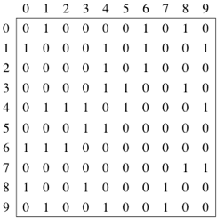
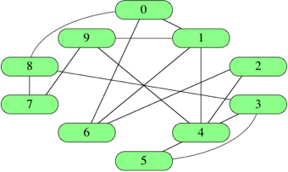
1. Adjacency matrix representation
Example :-

Slide 5
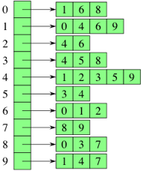
2. Adjacency lists representation
Example:-

Slide 6
BREADTH - FIRST SEARCH
Given a graph G = (V,E) and a distinguished source vertex s, breadth-ﬁrst search systematically explores the edges of G to “discover” every vertex that is reachable from s.
It computes the distance from s to each reachable vertex.
It also produces a “breadth-ﬁrst tree” with root s that contains all reachable vertices.
For any vertex v reachable from s, the simple path in the breadth-ﬁrst tree from s to v corresponds to a “shortest path” from s to v in G, that is, a path containing the smallest number of edges.
The algorithm works on both directed and undirected graphs.

Slide 7

ALGORITHM :-
BFS(G,s)
1 for each vertex u є G.V – {s}
2 u.color = WHITE
3 u.d = ∞
4 u.$π$ = NIL
5 s.color = GRAY
6 s.d = 0
7 s.$π$ = NIL

Slide 8

ALGORITHM :-
8 Q = ;
9 ENQUEUE(Q,s)
10 while Q != ;
11 u = DEQUEUE(Q)
12 for each v є G.Adj[u]
13 if v.color == WHITE
14 v.color = GRAY
15 v.d = u.d +1
16 v.$π$= u
17 ENQUEUE(Q,v)
18 u.color = BLACK

Slide 9
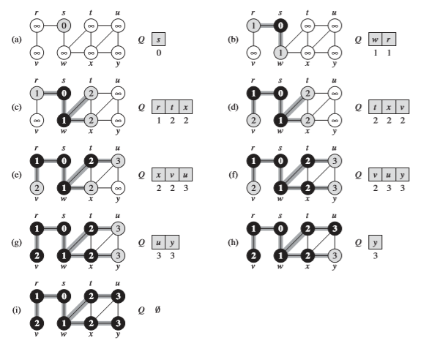
EXAMPLE PROBLEM :-

Slide 10
Time complexity analysis :-
The operations of enqueuing and dequeuing take O(1) time, and so the total time devoted to queue operations is O(V).
Because the procedure scans the adjacency list of each vertex only when the vertex is dequeued, it scans each adjacency list at most once. Since the sum of the lengths of all the adjacency lists is O(E). The total time spent in scanning adjacency lists is O(E).
The overhead for initialization is O(V) and thus the total running time of the BFS procedure is O(V+E).
Thus, breadth-ﬁrst search runs in time linear in the size of the adjacency-list representation of G.

Slide 11
Depth – first search
Depth-ﬁrst search explores edges out of the most recently discovered vertex v that still has unexplored edges leaving it.
Once all of v’s edges have been explored, the search “backtracks” to explore edges leaving the vertex from which v was discovered.
This process continues until we have discovered all the vertices that are reachable from the original source vertex.
If any undiscovered vertices remain, then depth-ﬁrst search selects one of them as a new source, and it repeats the search from that source.
The algorithm repeats this entire process until it has discovered every vertex.

Slide 12

Algorithm :-
DFS(G)
for each vertex u є G.V
u.color = WHITE
u. $π$ = NIL
time = 0
for each vertex u є G.V
if u.color ==WHITE
DFS-VISIT(G,u)

Slide 13

Algorithm :-
DFS-VISIT(G,u)
time = time + 1 // white vertex u has just been discovered
u.d = time
u.color = GRAY
for each v є G.Adj[u] // explore edge (u,v)
if v.color == WHITE
v. $π$= u
DFS-VISIT(G,v)
u.color = BLACK // blacken u; it is ﬁnished
time = time + 1
u.f = time

Slide 14
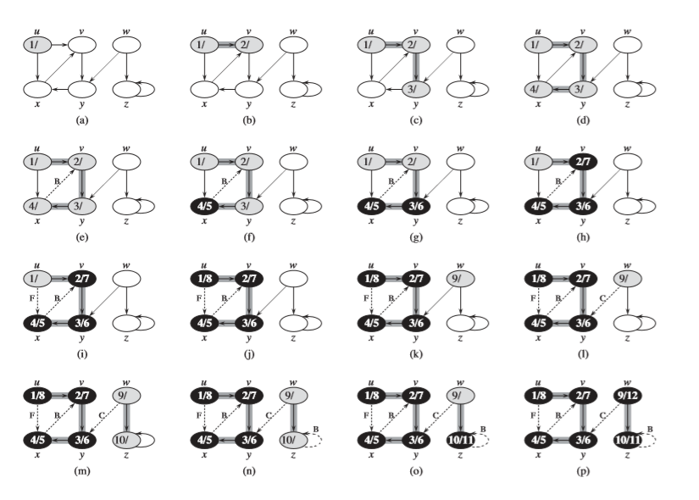
Example problem :-

Slide 15
Time complexity analysis :-
In DFS, you traverse each node exactly once. Therefore, the time complexity of DFS is at least O(V).
For a directed graph, the sum of the sizes of the adjacency lists of all the nodes is E (total number of edges).
So, the complexity of DFS is O(V) + O(E) = O(V + E).

